Slide 1
Research Posters
Design Tips

Slide 2
Plan your space and tools
Space
Tools
Will be using 42” by 42”
We recommend using Powerpoint and will provide a basic template that you can modify

Slide 3
Think of your audience
Who are they?
You will have three main sections- organize your information around them
What do they NEED to know vs. what would you like them to know?
Pay attention to the what why how when where
How will you show themes? (Themes are required)

Slide 4
Images
Photos, graphs, tables
Choose your images as you are figuring out your themes
Images should be relevant and highlight key ideas or data
Make sure they are high quality images that won’t be blurry (think MB, not KB)
If you are making your own tables and charts, make sure the font is big enough

Slide 5
Layout
Once you have your text and images, you can plan the layout of your poster
➔➔➔➔➔➔➔
⬇
⬇
⬇
⬇
⬇
⬇
⬇
⬇
⬇
⬇
⬇
⬇
⬇
⬇
⬇
➔➔➔➔➔➔➔
➔➔➔➔➔➔➔
Vertical
3 or 4 column

Slide 6
Apply design principles
Hierarchy
Readers need to know which information in most important
Create hierarchy by placement in a prominent position (middle or upper left) or highlighted with colour
Header text should be larger, maybe bold or a bright colour

Slide 9
Apply design principles
Consistency
Creates harmony and balance
Achieved via alignment, margins, font, shapes and colour
Use only one or two fonts and three to four font sizes (ie.for header, sub-header, body text and captions)

Slide 11
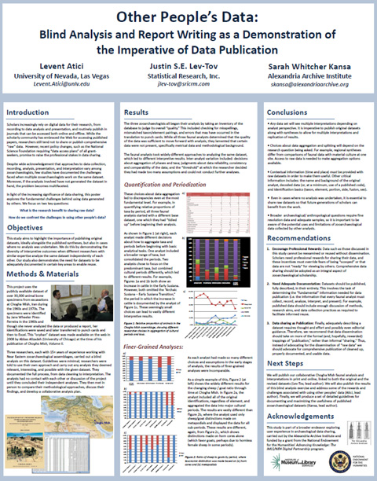

Slide 12
Apply design principles
Less is more
White space is important for legibility
Leave space between images and text, and give poster a good margin
Use colours sparingly

Slide 15
Activity
Use paper, pens and stickies to brainstorm how you want your information laid out. Remember, you are telling a story via text and graphics!

Slide 16
Printing locations
Document Solutions (SFU)- 97.50
East Van Graphics: about 45.00 http://www.eastvangraphics.ca/large-format-printing.shtml
Juke Box Print $75.00 plus tax and delivery if required.
http://www.jukeboxprint.com/full_colour_posters.php
Printprint.ca- 100.00 plus tax

