Slide 1
Graphics
Images, Diagrams, Maps and Infographics

Slide 2
Why use graphics?
Decorative
(Adds Visual Interest
Informative
(Shows relationships, explains issue)
Complex
(Tells a story)

Slide 3
Images
Images add interest and illustrate written ideas
Images as used for navigation are underutilized
Images:
should be relevant
should be clear
should not detract from the information you are trying to get across
Notes:
Everyone knows that images add visual interestm but images for navigation are underutliized. You can think of icons as images.

Slide 4
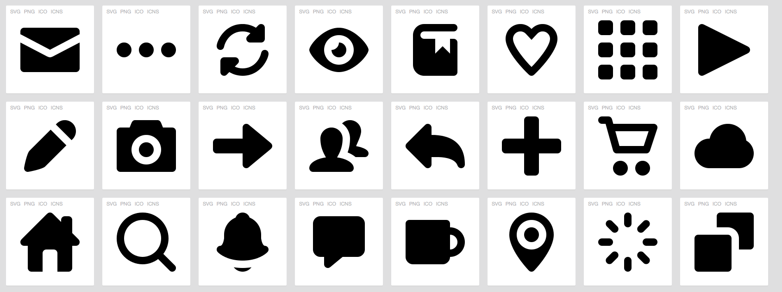
”Pictype Free Vector Icons" © Greg Grossmeier, used under a Creative Commons Attribution-ShareAlike license: http://creativecommons.org/licenses/by-sa/3.0/
”Couple Reading Books" © Greg Erin Kelly, ekelly89, used under a Creative Commons Attribution Licence: http://creativecommons.org/licenses/by/3.0/
Notes:
Using some simple icons can help learners organize the information, find relationships, and follow from a to b more easily.

Slide 5
Making and Finding Images
➔
Finding images:
Google Images (search using CC)
Download icons for free from sites such as http://findicons.com or https://www.iconfinder.com
Making images:
Edit your own photos using iPhoto or similar software (see our resource site for a list of tools)
Create icons, shapes, basic outlines using Microsoft Office, Inspire
☑

Slide 6
Charts, Graphs, Maps and Diagrams
Tools to visualize data.
From histograms to scatterplots- how do you find the right one?
http://www.labnol.org/software/find-right-chart-type-for-your-data/6523/
http://labs.juiceanalytics.com/chartchooser/index.html
Things to think about. Is your graphic:
Quick to understand
Clear titles and labels
Uncluttered
Appropriate for the job
Interesting to look at
Appropriate for context
ie. finely detailed=individual study
Maps
A visual representation of an area or symbolically depicting relationships
Don’t have to represent geographical space
Navigation aids
Notes:
Educational media is full of these elements, so I won’t go into too much detail. Here’s a link that details different kinds of graphs, etc.
But how do we recognize the good from the bad? Elements…
Maps are a bit more difficult. Go into details of maps.

Slide 7
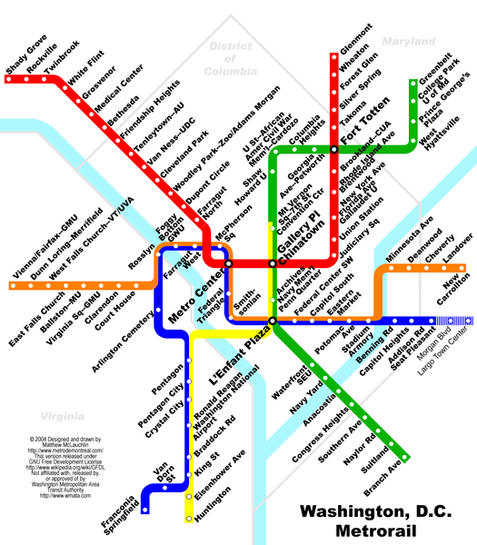
Maps don’t have to indicate space. And if they do, they don’t have to show distance.
Source: twu.org

Slide 8
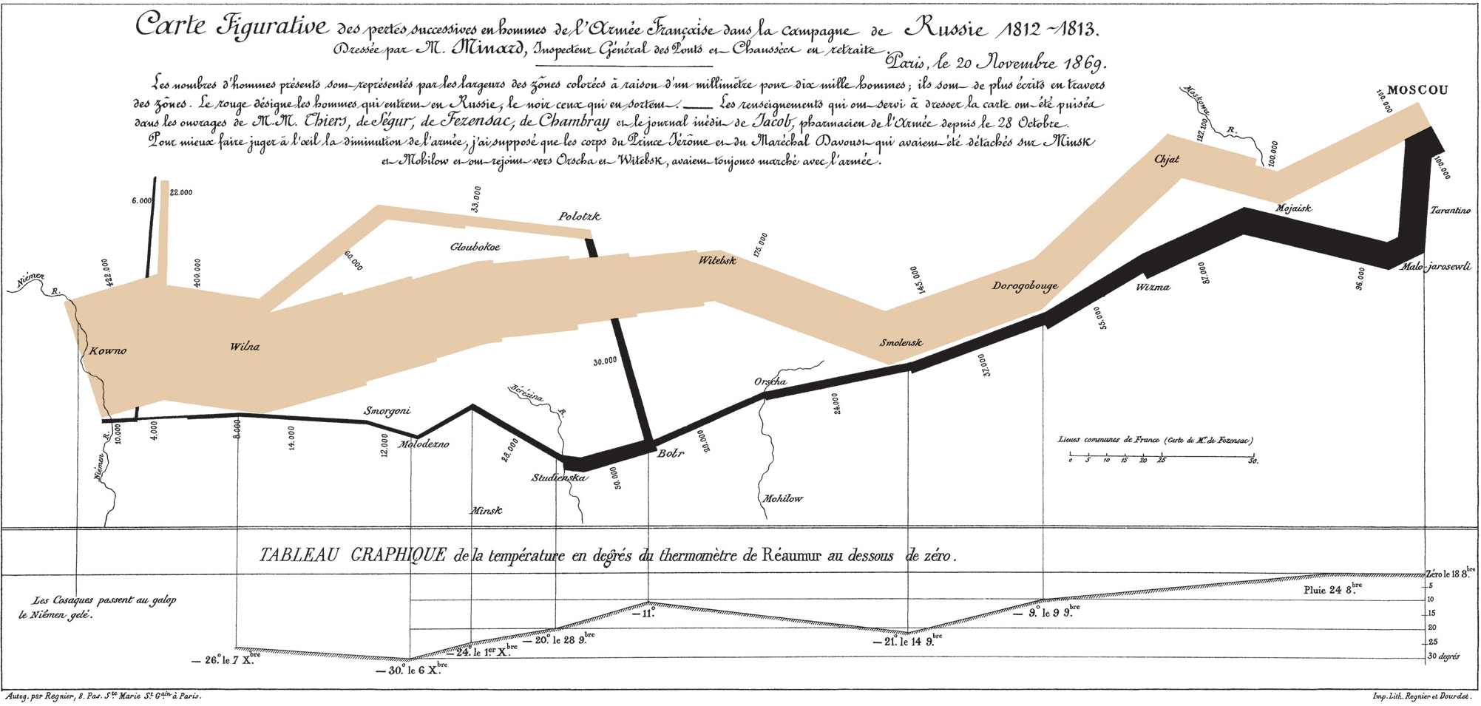
Map by Charles Joseph Minard, on Napolean’s Russian campaign of 1812.

Slide 9
Making/Finding Charts, Graphs, Maps and Diagrams
➔
Finding them
Google images
Other sites:
http://www.healthmetricsandevaluation.org/tools/data-visualizations
Gapminder
Making them
Use an online diagram-making tool like Cacoo.com
Use a drawing tool like Sketchbook Express or Paint
Please check our “Intro to software and hardware overview” on the EMP website
☑
Notes:
Discipline-specific sites often have sharing functions, or embedding codes, that allow you to place the graphics within your presentation.

Slide 10
Infographics
What ARE they and how are they different from graphics?
“Data sorted, arranged and presented visually.” (Visyal.ly)
Storytelling device
Three main elements: content, visuals and knowledge
Infographics are made up of charts, maps, and graphics (photos, illustration or other design elements)
The terms is evolving, right now also called editorial infographics or just graphics
…are they really that different from graphics?
Notes:
The Minard map I showed you earlier can actually be called an infographic.

Slide 11
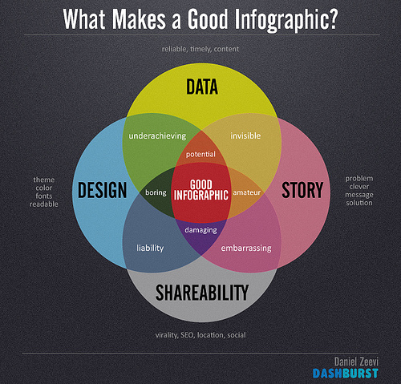
Daniel Zeevi, http://creativecommons.org/licenses/by-nd/2.0/ Creative Commons

Slide 12
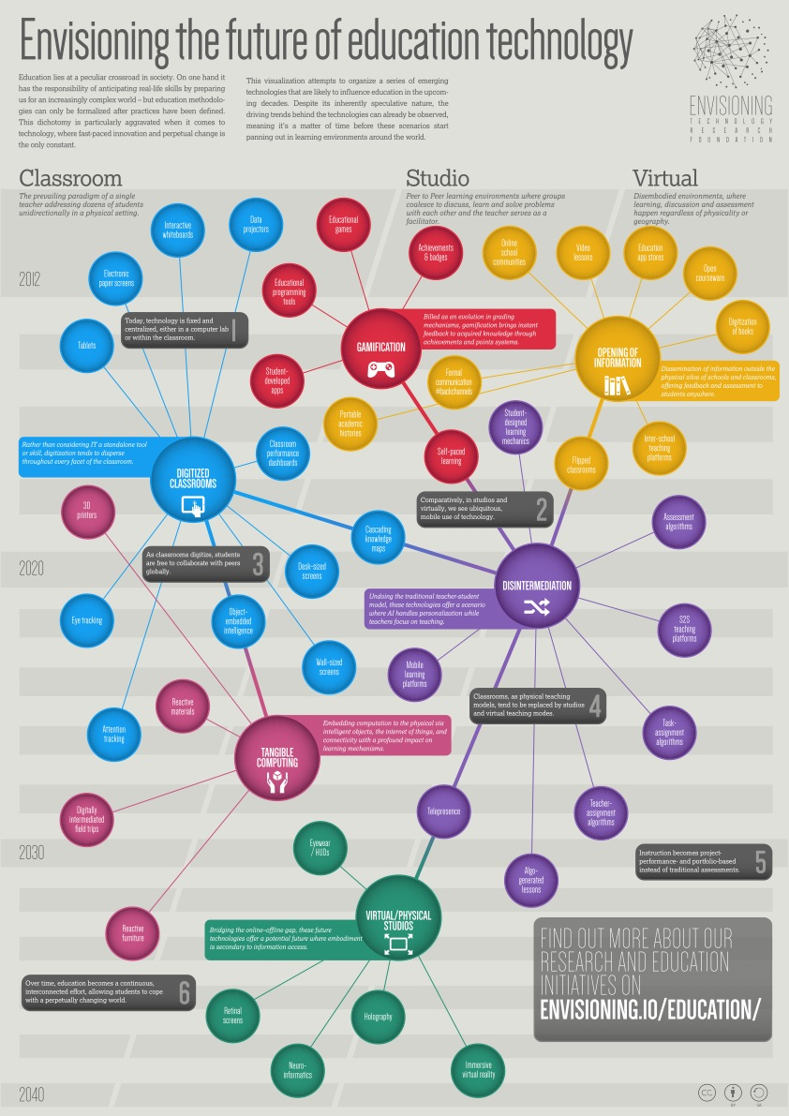
By the Envisioning Technology Research Foundation

Slide 13
Finding and Making Infographics
➔
Finding them
Google Images
Sites like http://www.topsite.com/goto/gapminder.org or http://www.topsite.com/goto/infosthetics.com
Making them
Piktochart
Easel.ly
Infogr.am
Dipity.com
Please check our “Intro to software and hardware overview” on the EMP website
☑

Slide 14
Important Tips!
Types of files
Be aware that there are many different type of graphic files- jpegs, gifs, pngs
Learn more about it here: http://sanstudio.com/tech/GraphicFileTypes.html
Pixelization
Reduces the effectiveness of your graphic
Learn more about it here: http://www.prepressure.com/design/basics/resolution

Slide 15
Homework: Make a Wordle
Select text you would like to use to create a word map. This can be any text, but it’s best if it’s more than a paragraph long.
Visit wordle.net
Cut and paste your chosen text into the text box.
You may then print the wordle or save it to a public gallery that you can link to (Caution: this gallery is public and can be viewed by any one.
Please bring to next workshop

